Slide 1
The effect of sleep quantity on neurological behavior of Drosophila melanogaster in open-field assays.
Titilayo Kuloyo, Spring 2021

Slide 2
Background
Sleep quantity has been linked to gene expression and cognitive response, negative cognitive response has been associated with sleep deprivation (Mackiewicz et al., 2007).
The periods of wakefulness in humans and animals are largely spent on responding to external stimuli using all sensory organs. Increase in habituation during wakefulness results in reduced attention and memory deficit (Vyazovskiy et al.,2017).
The effect of sleep quantity has also been observed in rodents and humans in studies related to memory reactivation, suggesting that sensory cues and sounds recognized during wake periods can be replicated during sleep thereby increasing memory replay and memory retrieval (Rasch, B., & Born, J.,2013).

Slide 3
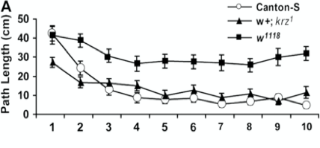
Background
Humans and drosophila exhibit a circadian rhythm sleep pattern regulated by genetic markers and biochemicals in both organisms. Similarities in molecular markers, easy breeding and production of offspring make drosophila an ideal model organism for neurobehavioral analysis (Dubowy, C., & Sehgal, A., 2017).
Previous experiments used genetically modified flies ( Canton-S, w⁺;krz¹ , w¹¹⁸) to demonstrate that the krz arrestin gene is responsible for high activity during period of exploration in Drosophila (Liu et al., 2007).
Purpose: To investigate the correlation between sleep quantity and neurological behaviors in Drosophila melanogaster how it is reciprocated in humans.
Research Question: is there a correlation between sleep and neurological behavior?
Fig 1. Path length of modified genotypes with 10-minute interval.

Slide 4
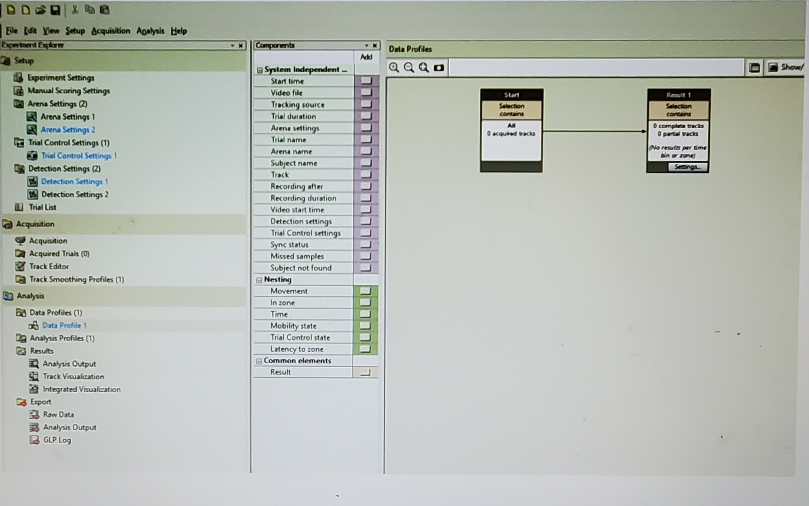
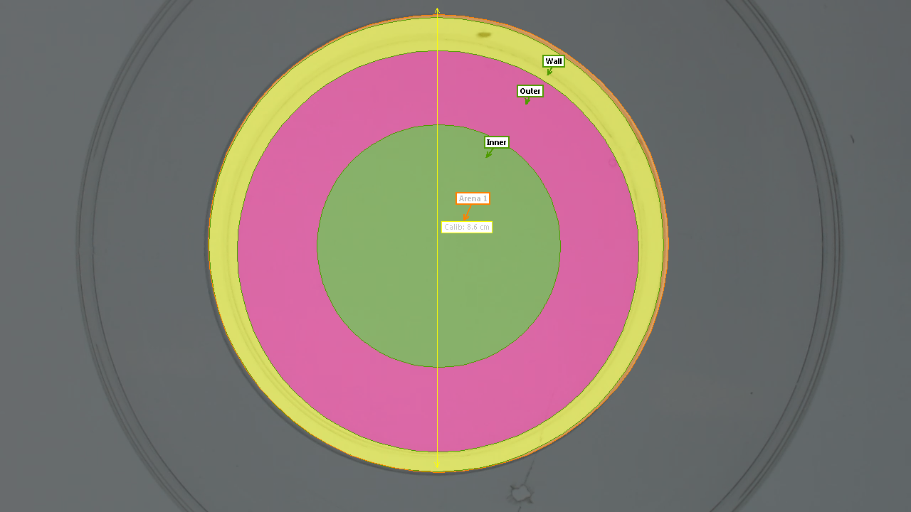
Methods
The research method used in this study is the open-field arena automated and analyzed by a video tracking software: Ethovision XT
Arena Setting and Zones: Scale is calibrated to 8.6cm. Wall is set to 8.6cm, Outer arena is set to 7.60cm, and inner arena is set 4.30cm.
Detection Setting – Automated setup with detection in all zones, ensuring fly is detected throughout the video.
Acquisition: Numerous planned trials can be selected using same arena and detection setting.
Analysis: Result setting (results per time bin). Dependent variables are Distance moved, velocity, Mobility state (mobile-immobile) frequency, cumulative duration.
Fig 2. Ethovision software setting for data acquisition.
Fig 3. Arena setting and zone colors.

Slide 5
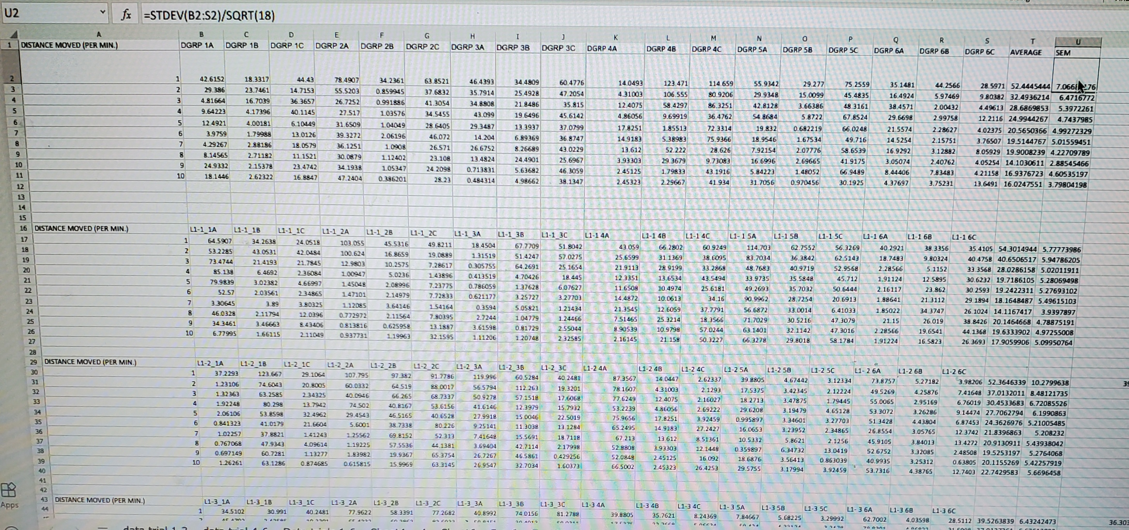
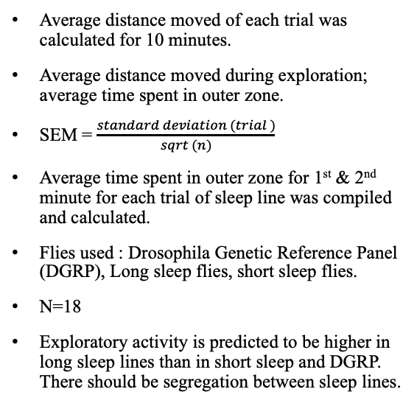
Experimental Design
Average distance moved of each trial was calculated for 10 minutes.
Average distance moved during exploration; average time spent in outer zone.
SEM = $\frac{standard deviation (trial )}{sqrt (n)}$
Average time spent in outer zone for 1st & 2nd minute for each trial of sleep line was compiled and calculated.
Flies used : Drosophila Genetic Reference Panel (DGRP), Long sleep flies, short sleep flies.
N=18
Exploratory activity is predicted to be higher in long sleep lines than in short sleep and DGRP. There should be segregation between sleep lines.
Fig 4. Data acquisition of trials on excel sheet

Slide 6
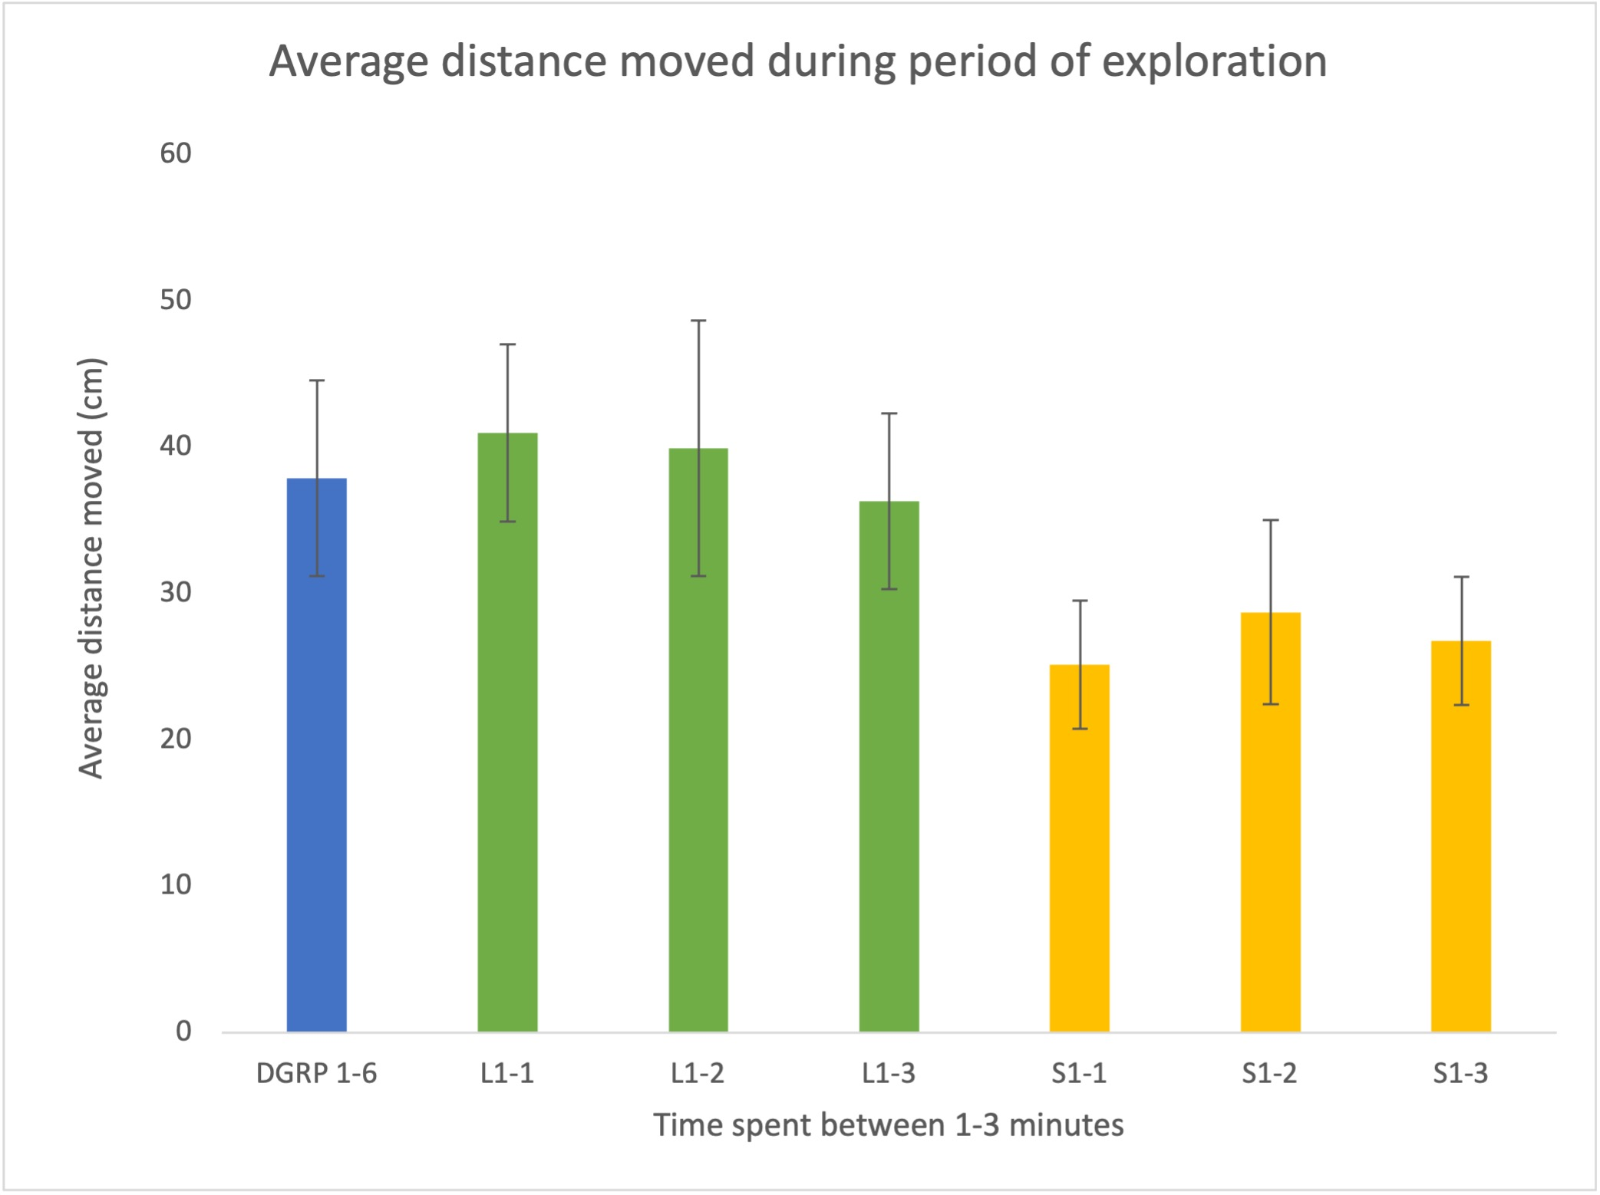
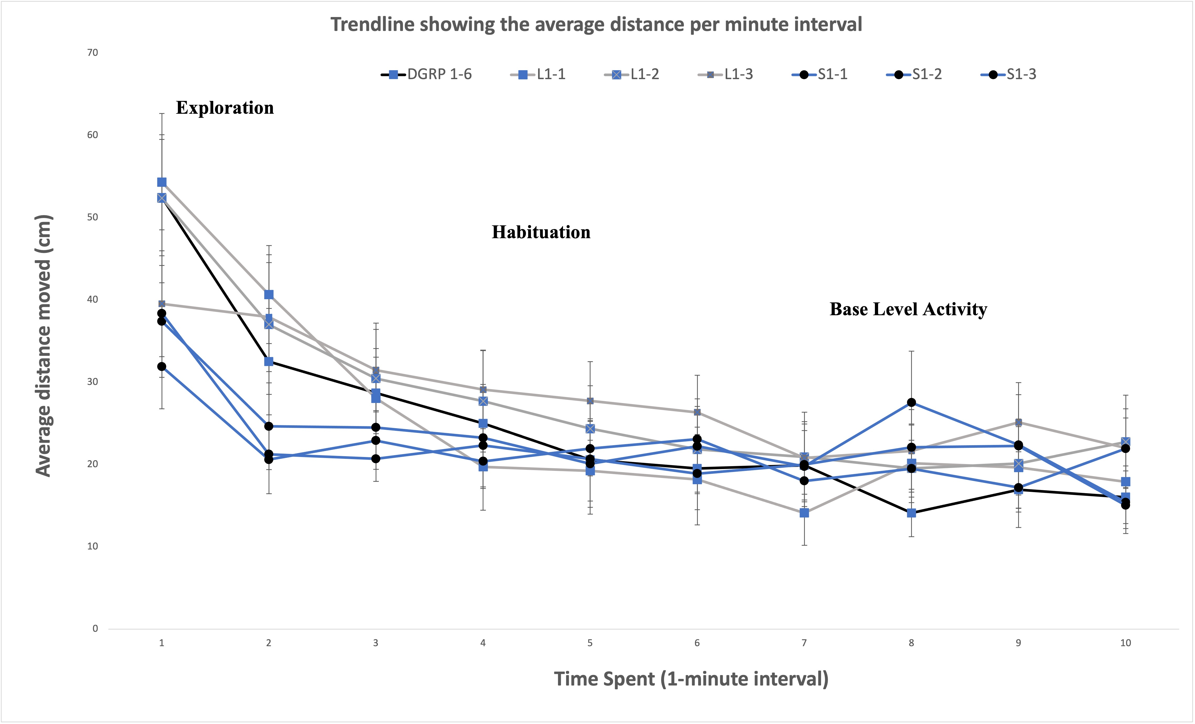
Results
Fig. 5: Average distance moved during period of exploration.
Fig 6: Average distance moved by flies in 10-minute interval.

Slide 7
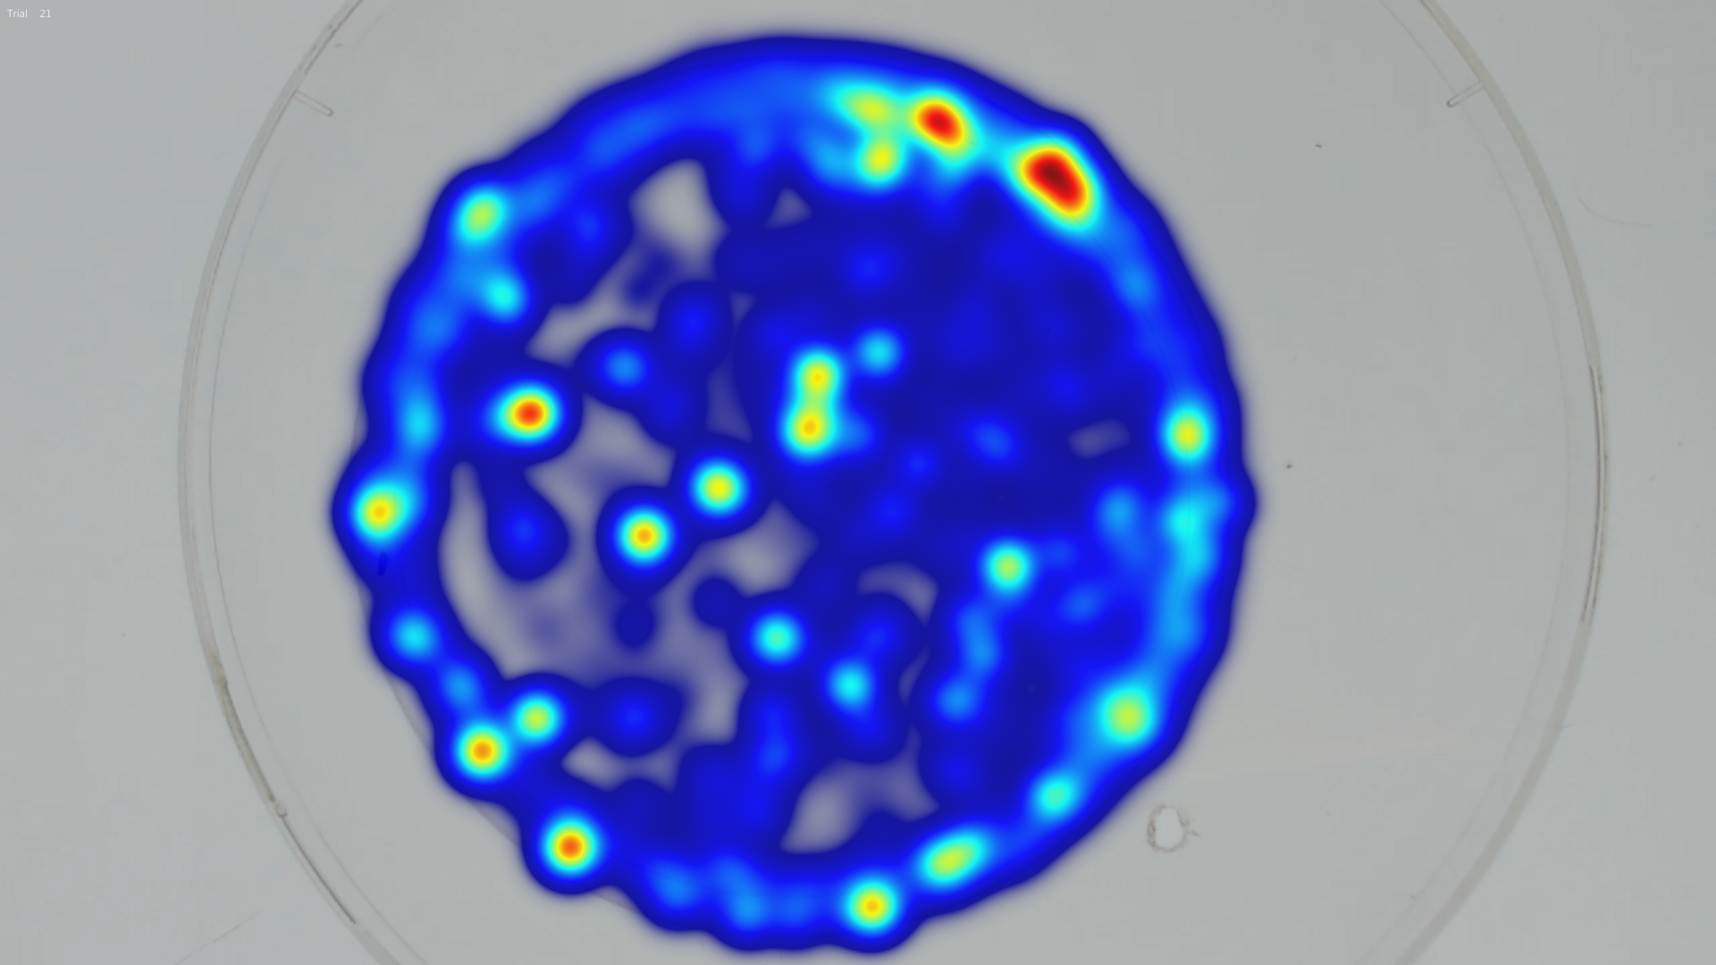
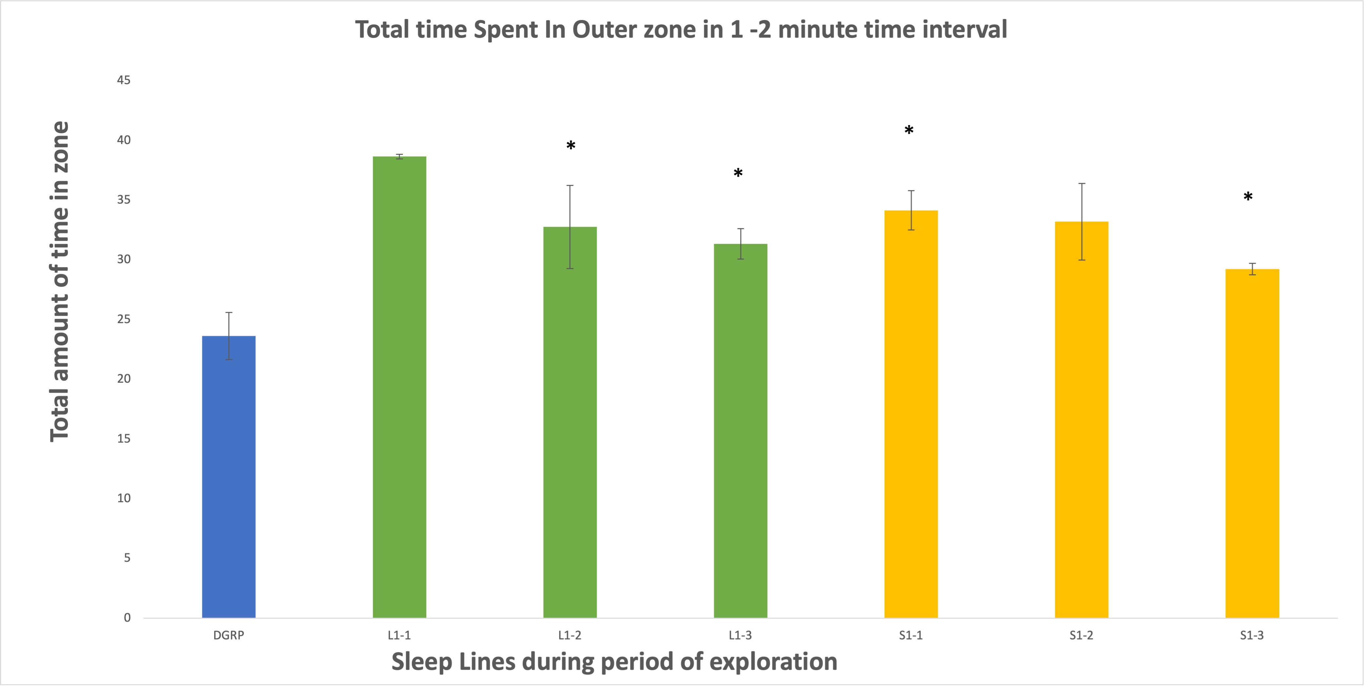
Results
P < 0.05 **
Trendlines show significant difference in time spent in outer zone during exploration by sleep lines.
Steady decline in exploration by DGRP, variation in decline of short sleep line and steady exploration in long sleep line.
The use of data analysis software allows for reliable data to be acquired and evaluated.
Fig 7. Heatmap visualization of time spent in zones by sleep line.
Fig 8: Total time spent by flies in outer zone during exploration.

Slide 8
Conclusion And Discussion
There is a correlation between sleep and neurological behaviors.
Segregation is observed between long sleep lines and short sleep lines.
Higher levels of activity are observed during exploration in long sleep lines than in short sleep lines.
Future experiment would include the use of more sleep lines as well as mutations in inbred lines to understand specific genes responsible for sleep variation.

Slide 9
Learning Reflection
Difficulties during project implementation were resolved by contacting former researcher(s) and researching articles on proposed topic.
The most important thing I have learned as a researcher is that research requires time management. It takes motivation to constantly try different methods to achieve adequate results.
Data analysis and data visualization were most learned and utilized skills in this research experience.

Slide 10
References
Mackiewicz, M., Shockley, K. R., Romer, M. A., Galante, R. J., Zimmerman, J. E., Naidoo, N., Baldwin, D. A., Jensen, S. T., Churchill, G. A., & Pack, A. I. (2007). Macromolecule biosynthesis: a key function of sleep. Physiological genomics, 31(3), 441–457. https://doi.org/10.1152/physiolgenomics.00275.2006
Vyazovskiy, V. V., Walton, M. E., Peirson, S. N., & Bannerman, D. M. (2017). Sleep homeostasis, habits and habituation. Current opinion in neurobiology, 44, 202–211. https://doi.org/10.1016/j.conb.2017.05.002
Rasch, B., & Born, J. (2013). About sleep's role in memory. Physiological reviews, 93(2), 681–766. https://doi.org/10.1152/physrev.00032.2012 Liu, L., Davis, R. L., & Roman, G. (2007). Exploratory activity in Drosophila requires the kurtz nonvisual arrestin. Genetics, 175(3), 1197–1212. https://doi.org/10.1534/genetics.106.068411
Dubowy, C., & Sehgal, A. (2017). Circadian Rhythms and Sleep in Drosophila melanogaster. Genetics, 205(4), 1373–1397. https://doi.org/10.1534/genetics.115.185157
Liu, L., Davis, R. L., & Roman, G. (2007). Exploratory activity in Drosophila requires the kurtz nonvisual arrestin. Genetics, 175(3), 1197–1212. https://doi.org/10.1534/genetics.106.068411

